Slide 1
JSON
Lesson 1 : JSON

Slide 2

Lesson Objectives
To understand the following topics:
  Introduction
  What is JSON ?
  Why JSON ?
  Using JSON
    Working with JSON and JavaScript
    JSON.stringify and JSON.parse
Notes:
Lesson 1:
1 JSON and Dojo
1.1 JSON(JavaScript Object Notation)
3.1.1 Data interchange using JSON
Explain the lesson coverage which is specified in notes pages in more details.

Slide 3
Introduction
JSON (JavaScript Object Notation), is a simple and easy to read and write data exchange format.
It’s popular and implemented in countless projects worldwide, for those don’t like XML, JSON is a very good alternative solution.

Slide 4
What is JSON ?
JSON is a lightweight text-based open standard data-interchange format.
You can read and write JSON easily.
JSON is derived from a subset of JavaScript programming language (Standard ECMA-262 3rd Edition—December 1999).
It is entirely language independent and can be used with most of the modern programming languages.
JSON files are saved with .json extension.
Internet media type of JSON is "application/json".

Slide 5
What is JSON ?
Language Independent
Text-based
Light-weight
Easy to parse
Not a document format
In JSON a data structure is a key / value pair. The key is a string, the value can be a numerical value, a boolean value (true or false) or an object
Lists are one or more values surrounded by [] and separated by ","
An object is a set of key / name pairs which starts with "{" and ends with "}".

Slide 6
JavaScript Object Notation (continued…)
An example JSON might look like the following.
{
firstName:'Lars',
lastName:'Vogel',
address: {
street:'Examplestr.',
number: '31'
}
}

Slide 7
JavaScript Object Notation (continued…)
The following is an example of an JSON object and its usage in JavaScript. You evaluate the JSON via the function eval and can then assign it to an object. This object can then be used in your JavaScript source code.
<!DOCTYPE HTML PUBLIC "-//W3C//DTD HTML 4.01 Transitional//EN"> <html>
<body>
<script type="text/javascript">
<!--Evaluate the object and assign to variables -->
var user = { firstName:'Lars', lastName:'Vogel', address: { street:'Examplestr.', number: '31' } };
<!--Use the object-->
alert(user.firstName + ' lives in street ' + user.address.street);
document.writeln(user.firstName + ' ' +user.lastName);
</script>
</body>
</html>

Slide 8
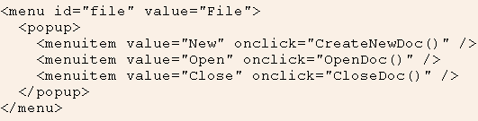
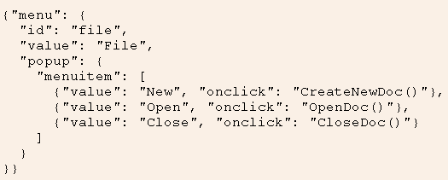
XML vs JSON

Slide 9
Why JSON ?
Because JSON is easy to write. It is just like creating and accessing class in javascript in object notation
If you like HashTables, you will fall in love with JSON.
It is easy to understand and can be integrated in any web application very easily .
Better organized data if prepared in well mannered way.
JSON is very fast.
JSON (JavaScript Object Notation) is an independent data exchange format.

Slide 10
Using JSON
Data interchange using JSON
  The key idea in Ajax
  An alternative to page replacement
  Applications delivered as pages
  How should the data be delivered ?

Slide 11
Using JSON
Data Formats
  Ad Hoc
  Database Model
  Document Model
  Programming Language Model

Slide 12
Values supported by JSON
Strings
Numbers
Booleans
Objects
Arrays
null

Slide 13
Strings
Sequence of 0 or more Unicode characters
No separate character type
  A characters is represented as a string with a length of 1
Wrapped in "double quotes“
Backslash escapement

Slide 14
Numbers
Integer
Real
Scientific
No octal or hex
No NaN or Infinity
  Use null instead

Slide 15
Booleans
true
false

Slide 16
null
A value that isn't anything

Slide 17
Object
Objects are unordered containers of key/value pairs
Objects are wrapped in { }
, separates key/value pairs
: separates keys and values
Keys are strings
Values are JSON values
  struct, record, hashtable, object

Slide 18
Object
{
"name": "Jack B. Nimble",
"at large": true,
"grade": "A",
"format": {
"type": "rect",
"width": 1920,
"height": 1080,
"interlace": false,
"framerate": 24
}
}

Slide 19
Array
Arrays are ordered sequences of values
Arrays are wrapped in []
, separates values
JSON does not talk about indexing.
  An implementation can start array indexing at 0 or 1.

Slide 20
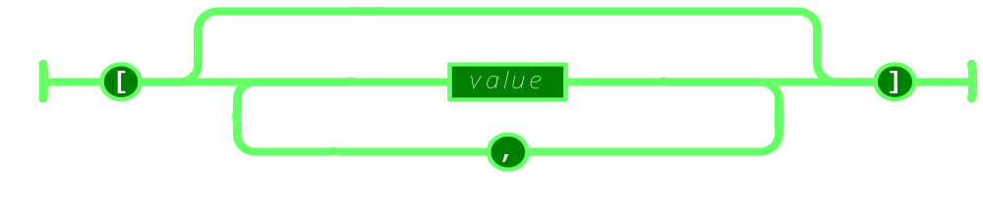
Array

Slide 21
Array
["Sunday", "Monday", "Tuesday", "Wednesday", "Thursday", "Friday", "Saturday"]
[
  [0, -1, 0],
  [1, 0, 0],
  [0, 0, 1]
]

Slide 22
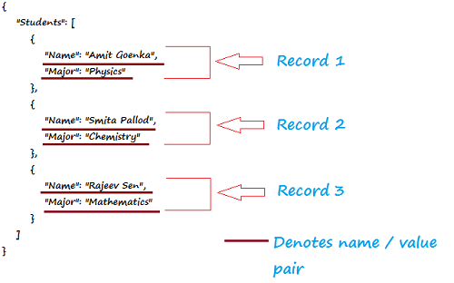
Array

Slide 23
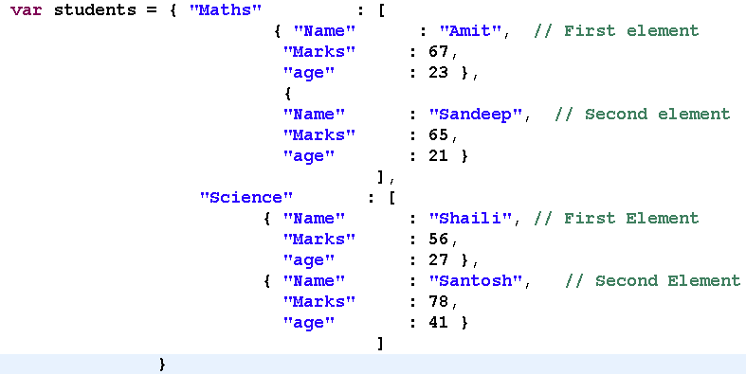
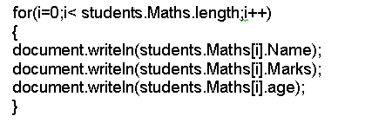
Working with JSON and JavaScript

Slide 24
Working with JSON and JavaScript
Extracting information
var myJSONObject = {"bindings": [
{"ircEvent": "PRIVMSG", "method": "newURI", "regex": "^http://.*"},
{"ircEvent": "PRIVMSG", "method": "deleteURI", "regex": "^delete.*"},
{"ircEvent": "PRIVMSG", "method": "randomURI", "regex": "^random.*"}
]
};
Members can be retrieved using dot or subscript operators
  myJSONObject.bindings[0].method // "newURI"

Slide 25
Working with JSON and JavaScript
myJSONtext
{"bindings": [
{"ircEvent": "PRIVMSG", "method": "newURI", "regex": "^http://.*"},
{"ircEvent": "PRIVMSG", "method": "deleteURI", "regex": "^delete.*"},
{"ircEvent": "PRIVMSG", "method": "randomURI", "regex": "^random.*"}
]
}
To convert a JSON text into an object, use the eval() function. eval() invokes the JavaScript compiler
  var myObject = eval('(' + myJSONtext + ')');

Slide 26
Demo
<html>
<body>
<h2>JSON Object Creation in JavaScript</h2>
<p>
Name: <span id="jname"></span><br />
Age: <span id="jage"></span><br />
Address: <span id="jstreet"></span><br />
Phone: <span id="jphone"></span><br />
</p>
<script type="text/javascript">
var JSONObject = {
"name":"John Johnson",
"street":"Oslo West 16",
"age":33,
"phone":"555 1234567"};
document.getElementById("jname").innerHTML=JSONObject.name
document.getElementById("jage").innerHTML=JSONObject.age
document.getElementById("jstreet").innerHTML=JSONObject.street
document.getElementById("jphone").innerHTML=JSONObject.phone
</script>
</body>
</html>

Slide 27
JSON.stringify and JSON.parse
serialize and deserialize
  Often you would find these two terms - serialize and deserialize. With the context of working with JavaScript and JSON, in a nutshell, to get JSON value from JavaScript value is serialization and when it's other way (JSON to JavaScript) is deserialization.
JavaScript JSON object
  The JavaScript JSON object comprises methods using which you can convert JavaScript values to JSON format and JSON notation to JavaScript values. We will now discuss two JSON methods
    JSON.stringify and JSON.parse with examples.

Slide 28
JSON.stringify
JSON.stringify is used to convert JavaScript values to JSON.
<html xmlns="http://www.w3.org/1999/xhtml">
<head>
<title>JavaScript JSON.stringify example | JSON tutorial | w3resource</title>
<meta http-equiv="Content-Type" content="text/html; charset=utf-8" />
</head>
<body onload="w3resource();">
<h1>This is an example of JavaScript JSON.stringify</h1>
<script type="text/javascript">
function w3resource()
{
var w3r = {};
w3r.json = "w3resource JSON tutorial";
w3r.Examples = 500;
var w3r_JSON = JSON.stringify(w3r);
// w3r_JSON holds {“json":"w3resource JSON tutorial","Examples":500}
alert (w3r_JSON);
}
</script>
</body>
</html>

Slide 29
JSON.parse
JSON.parse is used to convert JSON notation to JavaScript values.
<html xmlns="http://www.w3.org/1999/xhtml">
<head>
<title>JavaScript JSON.parse example | JSON tutorial | w3resource</title>
<meta http-equiv="Content-Type" content="text/html; charset=utf-8" />
</head>
<body onload="w3resource();">
<h1>This is an example of JavaScript JSON.stringify</h1>
<script type="text/javascript">
function w3resource()
{
var w3r = {};
w3r.json = "w3resource JSON tutorial";
w3r.Examples = 500;
var w3r_JSON = JSON.stringify(w3r);
// w3r_JSON holds {“json":"w3resource JSON tutorial","Examples":500}
alert(w3r_JSON);
var convertToJS = JSON.parse(w3r_JSON);
var StringAgain = JSON.stringify(w3r);
alert(StringAgain);
}
</script>
</body>
</html>
Notes:
JSONPath is a lightweight library to find and extract sections from a JSON data. It can be used with both JavaScript and PHP.
To work with JSONPath and JavaScript, you need to download jsonpath.js. You can download it from http://code.google.com/p/jsonpath/.
Once downloaded, you need to include the said js file in your webpage and you are ready to use it.
Example:
<html xmlns="http://www.w3.org/1999/xhtml">
<head>
<title>JavaScript JSONPath example | JSON tutorial | w3resource</title>
<meta http-equiv="Content-Type" content="text/html; charset=utf-8" />
<script type="text/javascript" src="/JSON/json.js"></script>
<script type="text/javascript" src="/JSON/jsonpath.js"></script>
</head>
<body>
<h1>This is an example of JavaScript with JSONPath</h1>
<script type="text/javascript">
var json = { "MovieDatabase": {
"movie": [
{ "name":"The Change-Up",
"genre": "comedy",
"director": "David Dobkin",
"Facebook_like": 252
},
{ "name":"Rise of the Planet of the Apes",
"genre": "SciFi",
"director": "Rupert Wyatt",
"Facebook_like": 472
},
{ "name":"30 Minutes or Less",
"genre": "adventure",
"director": "Ruben Fleischer",
"Facebook_like": 114
},
{ "name":"Final Destination 5",
"genre": "Horror",
"director": "Steven Quale",
"Facebook_like": 241
}
]
}
};
result = "";
result += jsonPath(json, "$.MovieDatabase.movie[*].director").toJSONString() + "<br />";
//find all directors result += jsonPath(json, "$..director").toJSONString() + "<br />";
//find all directors result += jsonPath(json, "$.MovieDatabase.*").toJSONString() + "<br />";
//find all movies result += jsonPath(json, "$.MovieDatabase..Facebook_like").toJSONString() + "<br />";
//find all facebook lies of all the movies result += jsonPath(json, "$..movie[(@.length-1)]").toJSONString() + "<br />";
//the last movie in data result += jsonPath(json, "$..movie[-1:]").toJSONString() + "<br />";
//the last movie in data result += jsonPath(json, "$..movie[0,1]").toJSONString() + "<br />";
//first two movies result += jsonPath(json, "$..movie[:3]").toJSONString() + "<br />";
//first three movies result += jsonPath(json, "$..movie[?(@.genre)]").toJSONString() + "<br />";
//all movies with genre result += jsonPath(json, "$..movie[?(@.Facebook_like>200)]").toJSONString() + "<br />";
//movies with facebook like more that 200 result += jsonPath(json, "$..*").toJSONString() + "\n";
// all members in the JSON document document.write(result);
</script>
</body>
</html>

